Slide 1
Research Methods in Criminal Justice
Lesson 4
Lorne Gibson, Ed.D., Ph.D.
Assistant Professor of Criminal Justice gibsonlo@uwplatt.edu
Ph. 608-342-1419
Office: 1168 Ullsvik Hall

Slide 2
Lesson Objectives
Know:
Major research Ethics Areas
No Harm
Voluntary Participation of Subjects
Anonymity and Confidentiality
Deception
Analysis and Reporting
Legal Liability
Appreciate Ethical Considerations
(Knowledge, Prediction, Control) VS. Harm
Participation Issues
Deception
Non-Volunteers
Participant Observation
Anonymity or Confidentiality
Legal Liability

Slide 3
Functions of Theory
Explanation
Why the phenomena is the way it is.
Prediction
Proposing the occurrence of a future event.
Control
Proposing the ability to intervene or alter future event

Slide 4
Parts of Theory
Constructs
High-level abstract description of phenomena using concepts in definition
Justice (fairness, equality, peace), capitalism(ownership, labor, surplus), self-esteem,
Concepts
Mental grouping of similar objects, events, ideas, or people
Assumptions/Axioms/Postulates
Statements about constructs that logically support resulting construct relationships
ie Humans, due to instinct to avoid anxiety, learn to play roles that reduce anxiety
Propositions
Logical concept relationships derived from Assumptions
Low anxiety roles will be performed more than high anxiety roles
Indicators
Concepts that indicate construct occurrence/presence
Hugging = love, punching=hate, income=power

Slide 5
Parts of Theory & Research
Definitions
Constitutive: a definition of a construct using other constructs
Operational definition
Measured: one that describes how a variable will be measured
Experimental: spells out the details of the manipulation of variables. I will punch the subject in the face, gut, and groin to introduce “pain”.

Slide 6
Theory Models
SOCIAL DEVIANCE INTEGRATED THEORY
Symbolic Interaction: meanings/ ideologies
Individual Interactions
Roles/Cultural References
Stigmas/Stereotypes/prejudices
Resource Possession
Goals: Aspirations
Competition for Resources
STRAIN
Goal/Means Dissonance
Prescriptional
Anomie
Structural Anomie
Goal/Means Dissociations:
Anticipational Anomie
Subcultures: cultural adaptations
Cultural Patterns & Individual Adaptations:
Conformity
Ritualism, Innovationism,
Retreatism,
Rebellion
Morality
Deviance
Deviation
Defiance
Behavior & Attitudes

Slide 7
Theory Build
Constructs, Assumptions, Propositions, Indicators
Teen Pregnancy
Education
intercourse
Gender
Media
Poverty
Self-esteem
Physical
Abuse
Obesity
Drug Abuse
Parental Presence
Social Disorganization
??????
Gangs
Crime
Resources
Intelligence
Adult Mentoring

Slide 8
Evaluating Theory
Scope: how many of the basic problems in the discipline are handled by the same theory.
Broad domain or large number of situations
Precision of Prediction
Accuracy of Explanation: is the assumptions/premise accurate
Parsimony: Amount of assumptions
Heuristic Value: potential for generating research and additional theory

Slide 9
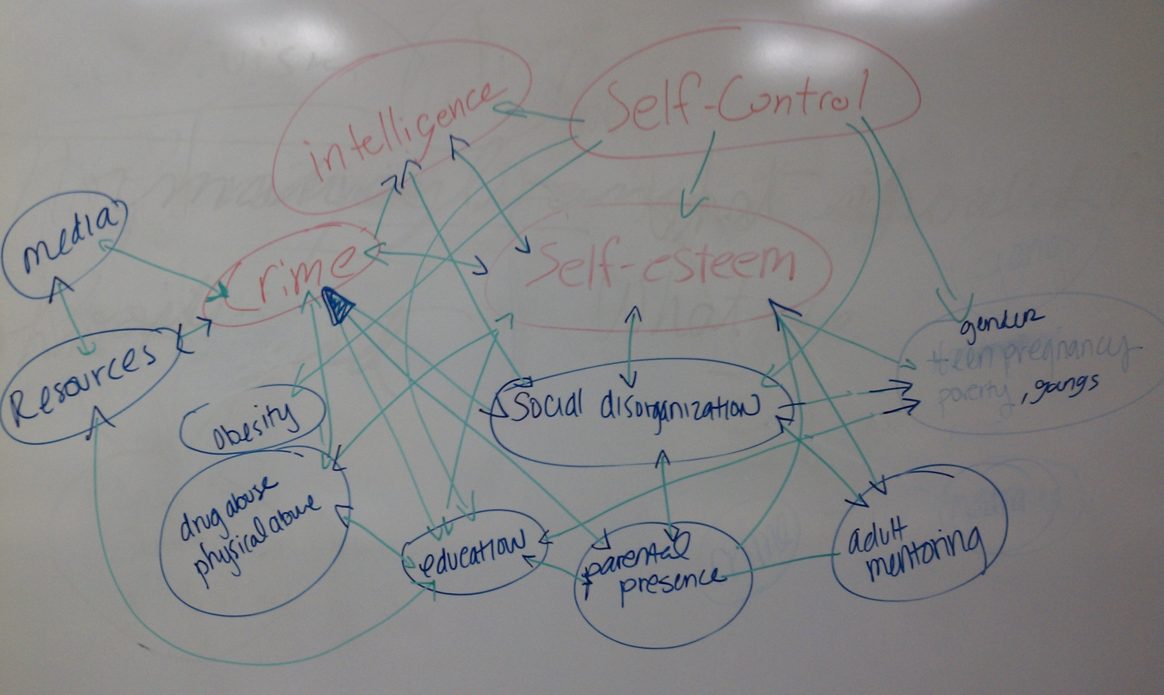
Everything is related?

Slide 10
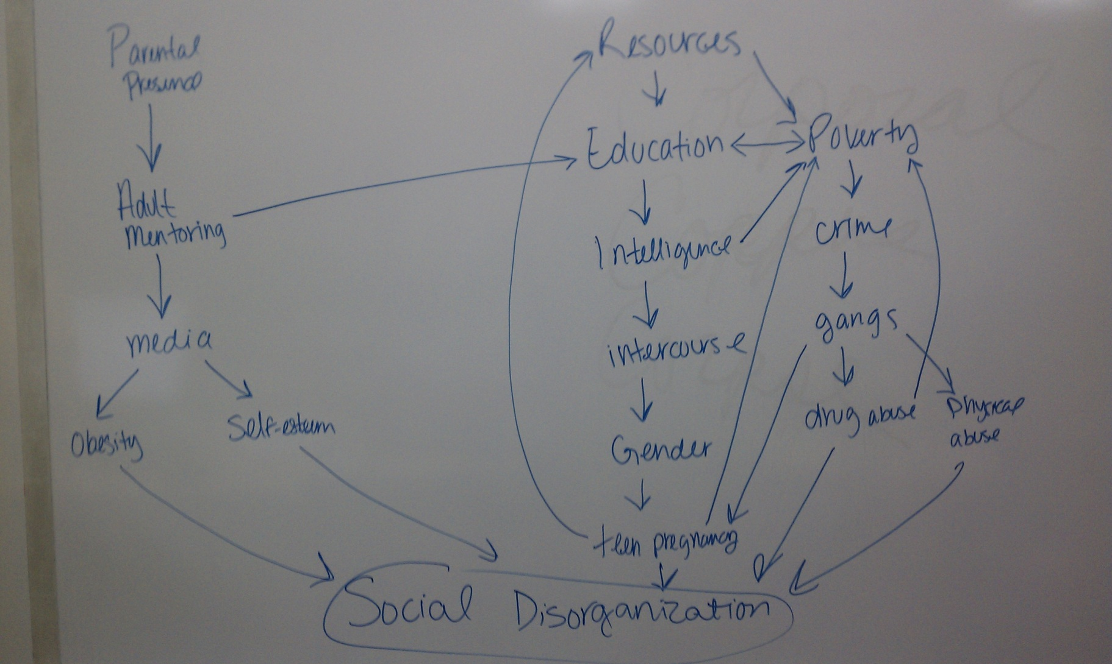
What are “resources”?

Slide 11
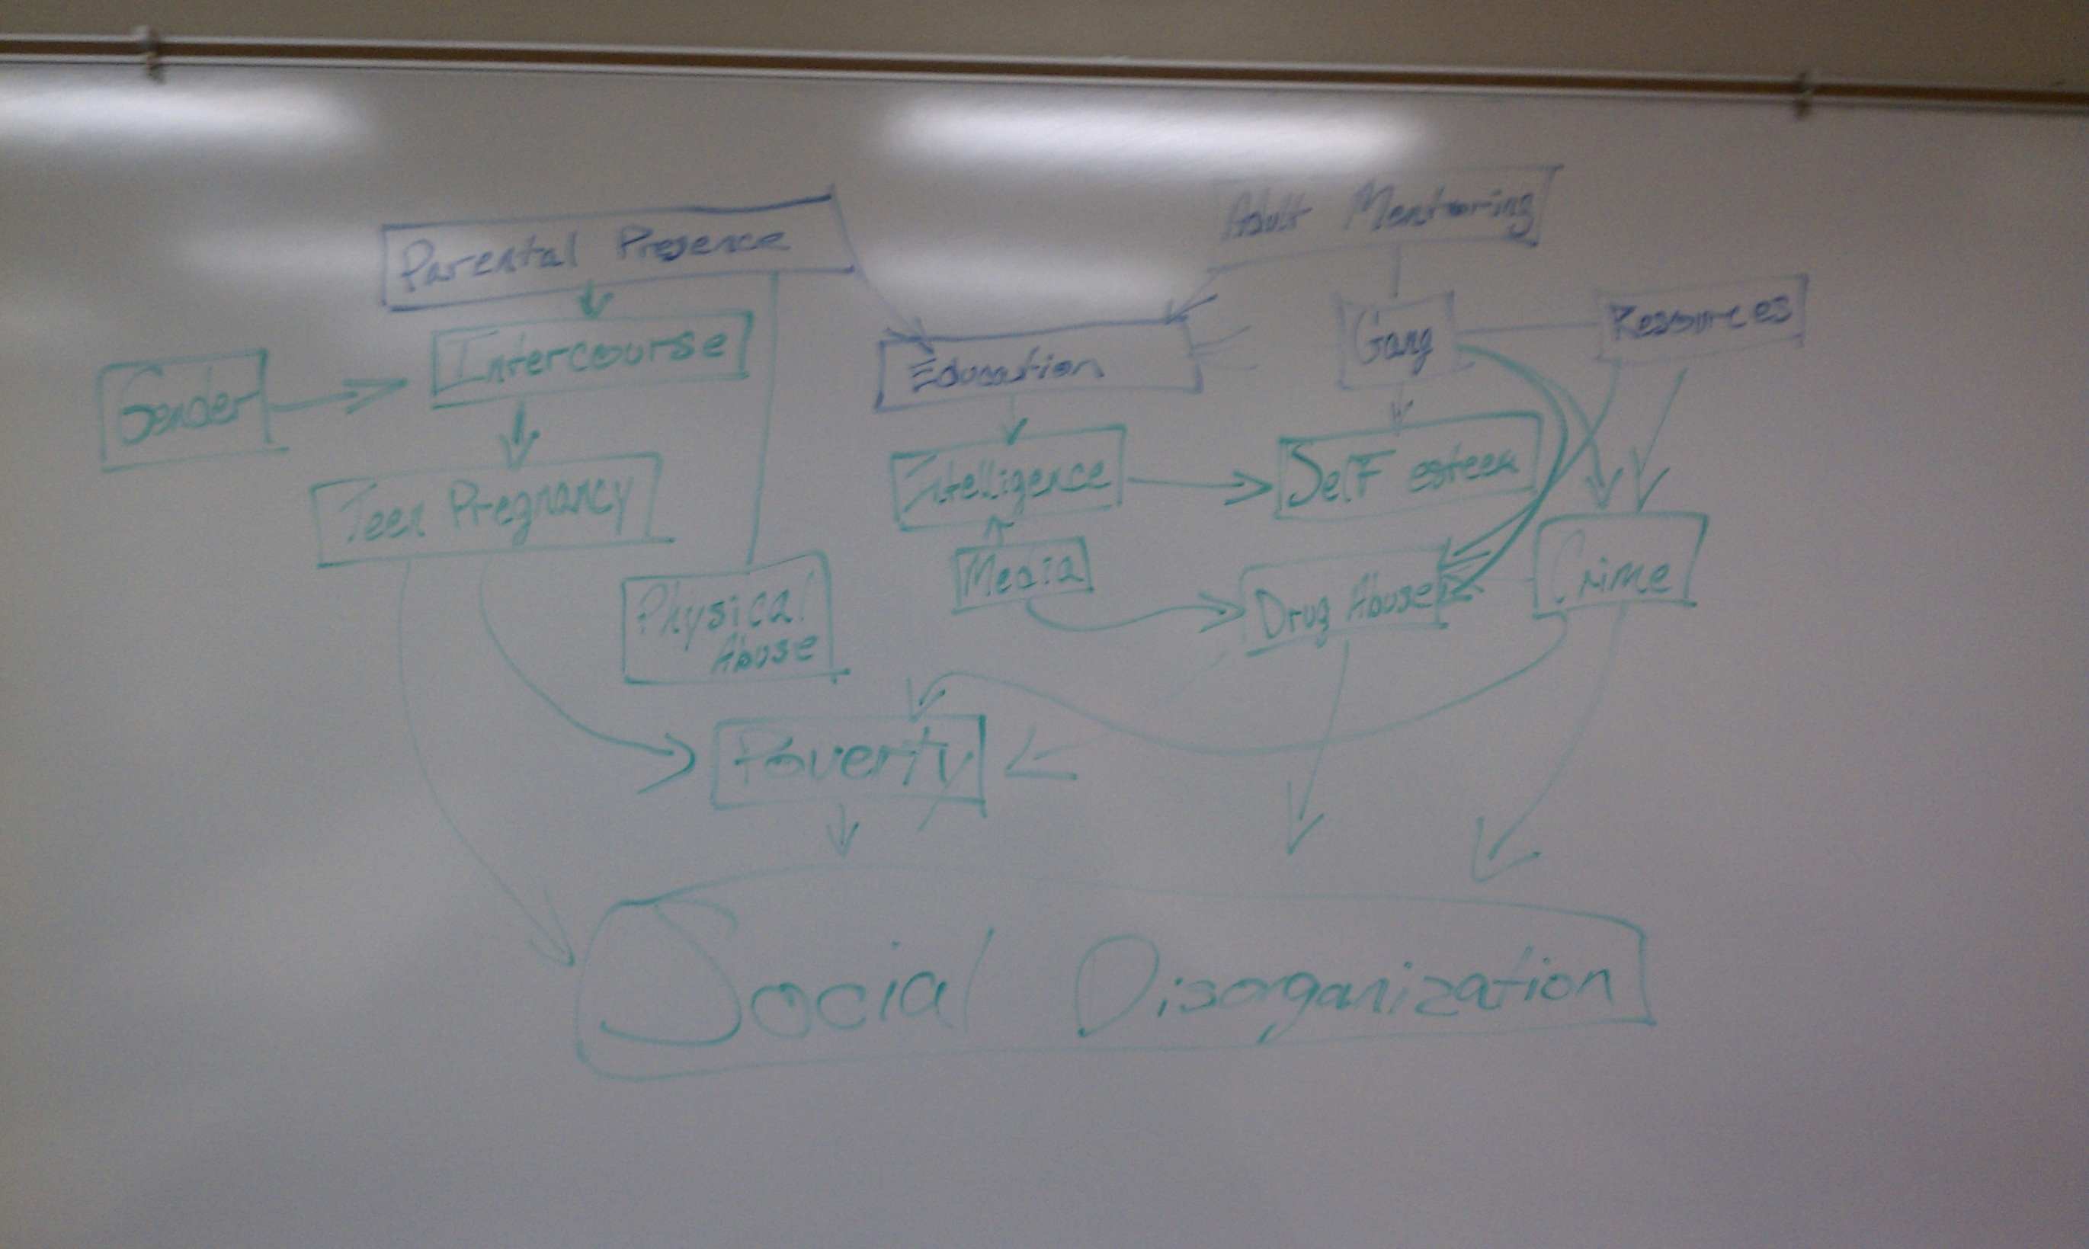
Gender causes Intercourse!!!!

Slide 12
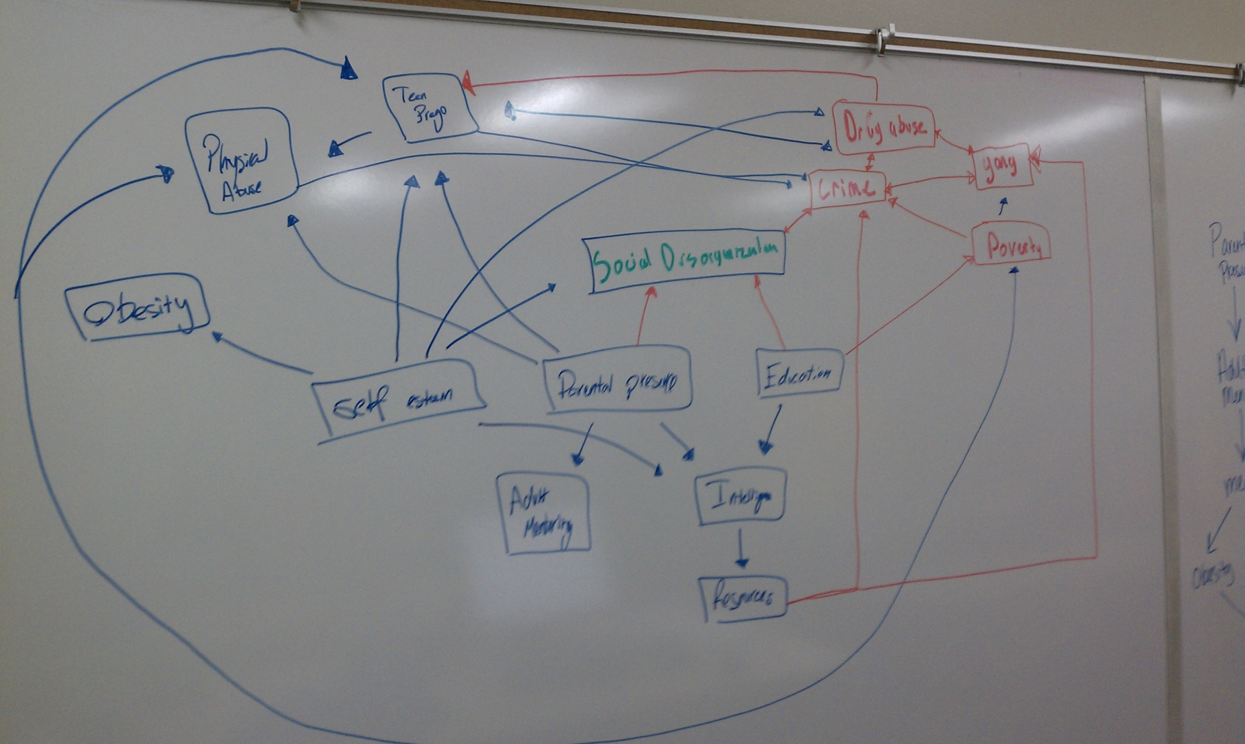
What does effect self-esteem?

Slide 13
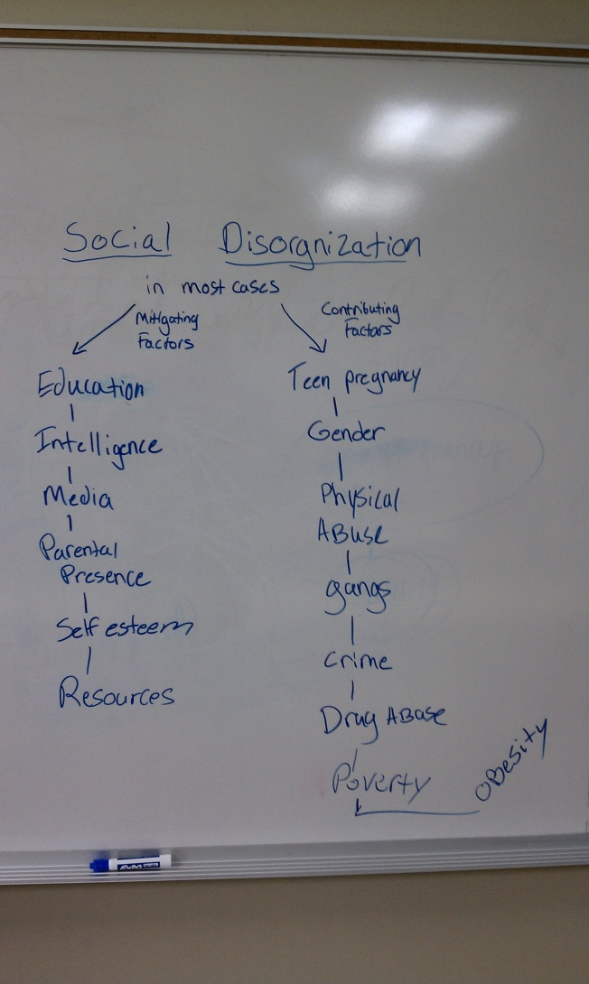

Slide 14
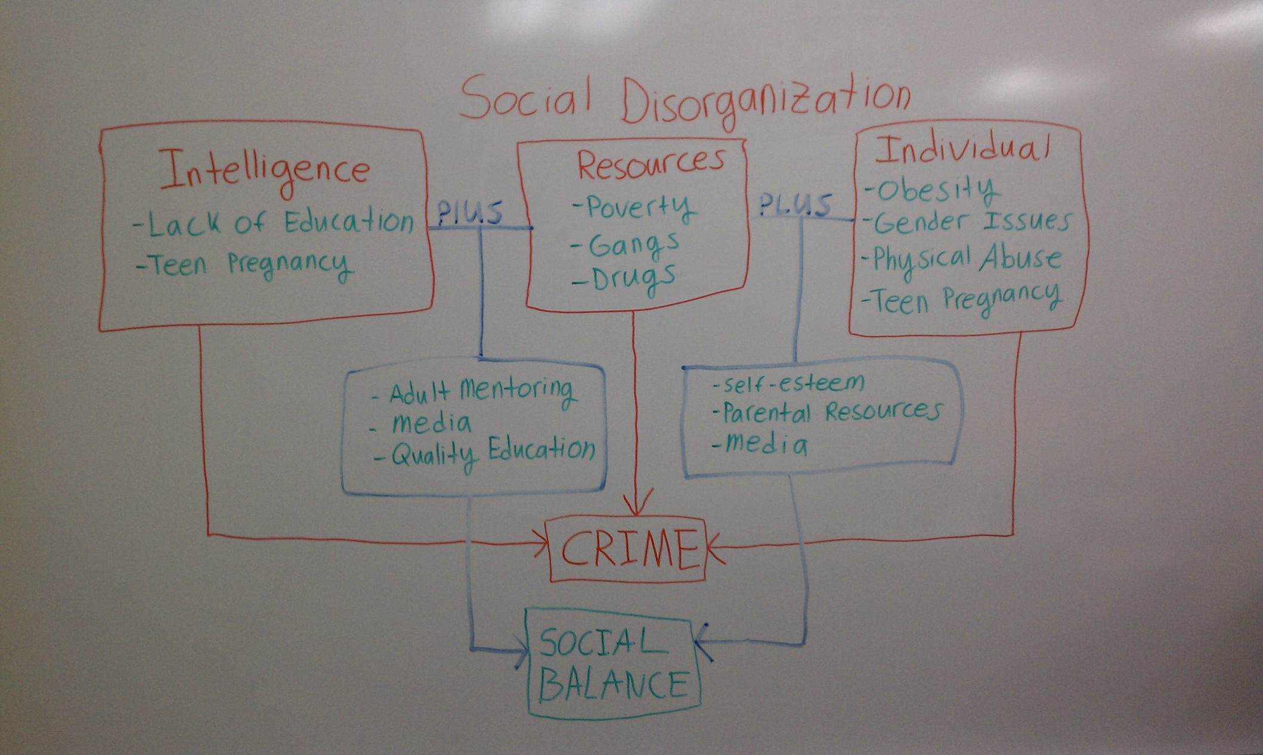
Really close?

Slide 15
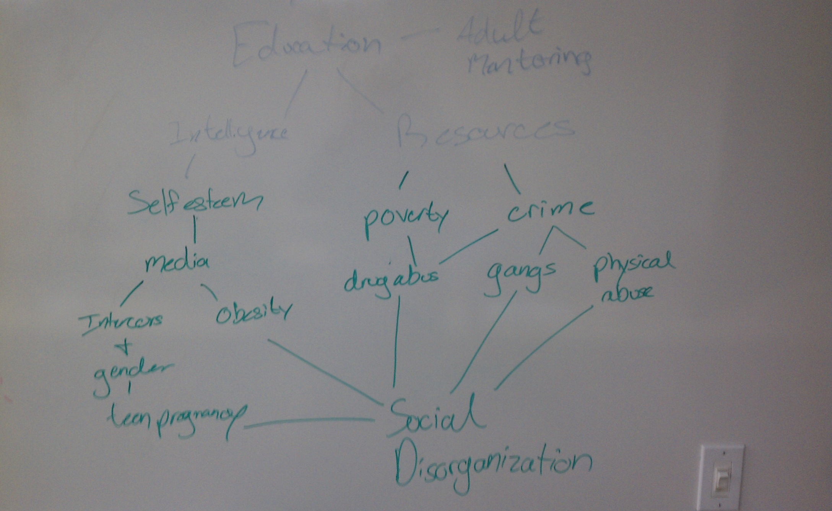
11 AM Winner!!!

Slide 16
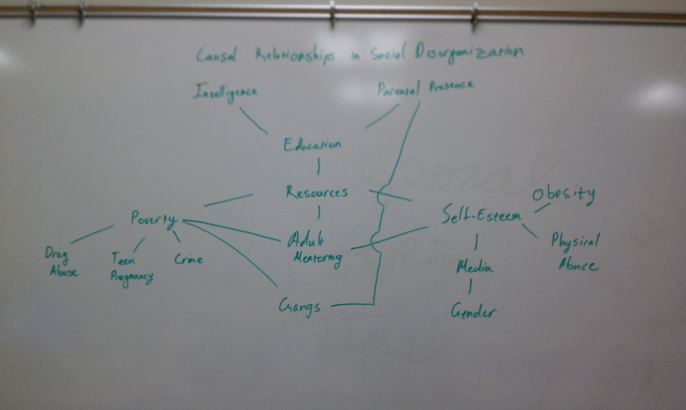
1 PM Winner!!!!

Slide 17
Major Ethical Areas
Harm
Psychological
Professional/Economical
Interpersonal
Physical
Withholding Assistance
Victims
Subjects
Researchers
Organizations
Society (is the research causing crime…where?)

Slide 18
Voluntary Participation (Consent)?
Solicitation for Participation
Calling, Mailing, Airports, street corners, malls
Takes time to decline (participation?)
Compensation for Participation
Money, candy, favors, personal benefit
Compelled to participate (owe them, need the money)
Fear of Non-participation
Positive or negative punishment
I will lose favor, I’ll get a lower grade

Slide 19
Anonymity or Confidentiality
Anonymity
Subject’s information cannot be associated with observations
Confidentiality
Subject’s information can be associated with observations, but this is not reported or released to non-researchers
Mandatory Reporting?
Probation Program Evaluation/Officers make false reports

Slide 20
Informed Consent, Disclosure, Nondisclosure, or Deception
Disclosure of research purpose and/or methods may range and vary:
Total disclosure. Informing subjects of true purposes and procedures.
Partial disclosure. Informing subjects of some aspects about purposes and procedures.
Nondisclosure. Hiding all aspects of research from subjects.
Covert research. Subjects are unaware of research at all.
Purpose and Procedure Deception. Subjects are aware of research but are told untruths regarding purpose and/or procedures.
Experimental Deception. Deception is part of the procedures or are an experimental variable.
Informed consent? Verbal, written

Slide 21
Analysis and Reporting Integrity
Accurate procedural reporting
Manipulations of variables
Ignored observations
Negative findings
Initial proposition and hypotheses accuracy
Accurate findings and conclusions

Slide 22
Benefits vs. Harm
Balance between:
Knowledge gained and harm
Prediction capabilities gained and harm
Control gained and harm

Slide 23
Tearoom
Anonymity?
Confidentiality?
Harm?
Unlawful?
Mandatory reporting?

Slide 24
For Next Lesson
Read Chapter 4 of Maxfield & Babbie text.
Get lots of sleep
Eat healthy
Exercise
Enjoy life.

